Slide 1
THAT WAS THEN…
…THIS IS NOW!
2011 Brand Market Assessment
June, 2011

Slide 2
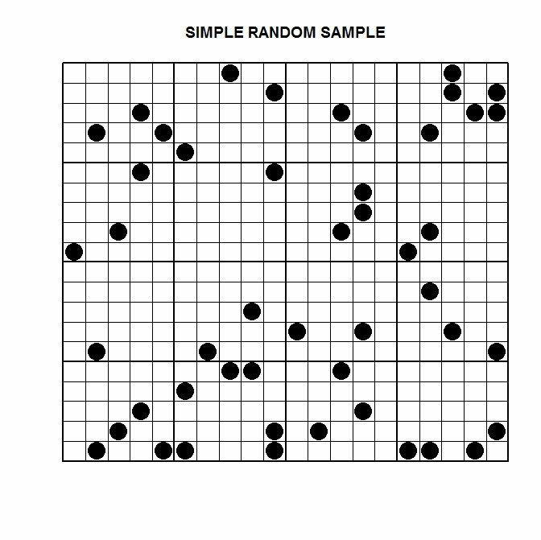
High School Students
Incumbent Workers/
Unemployed Adults
Objectives
&
Measurement
Pursuing Baccalaureate Degrees
Gainful Employment

Slide 3
A significant research design measuring five segments using large sample sizes was repeated in 2011.
A Comprehensive Market Analysis
800 Older Prospects, 19-54 with no college degree and not currently enrolled in postsecondary education (Telephone/online)
740 Younger Prospects, junior & senior high school students (Telephone)
350 Parents of high school students (Telephone)
320 Teachers & Counselors (On-line)
Eight (8) Focus Groups
(“At Risk Students”, minority & rural)
- Louisville - Hazard
- Hopkinsville - Somerset
2006
THEN
2011
NOW

Slide 4
The four regions were designed to be as contiguous as possible to the 16 college markets with sufficient sample sizes to identify regional differences.
Weighted for special sampling needs
West Central Urban East

Slide 5
The Changing Educational
Landscape

Slide 6
Educational status in Kentucky is changing for the better. More persons have been exposed to a postsecondary educational experience.
Older Prospects
Parents
+12
+9
Associate degrees/Some
postsecondary training
College/Associate degrees/Diploma or certificate.

Slide 7
Interest in pursuing more education is up.
Older Prospects
Likelihood To Enroll In College
+6
34%
28%
+3
Somewhat Likely
+3
Extremely/Very Likely

Slide 8
The young and impressionable had the same high aspirations as they did five years ago. Almost everyone plans to go to college after high school.
High School Students
Likelihood To Enroll In College

Slide 9
KCTCS has been a significant part of educational change. Combined with state universities, approximately 20,000 more students enrolled in 2010, compared to 2006.
An increase of 7% over five years
126K
118K
107K
85K
An increase of 26% over five years
Source: Kentucky Council On Postsecondary Education

Slide 10
The Changing
Economic
Landscape

Slide 11
The economy of the past five years has had a dramatic impact on many people’s “world view.” Education was no exception.
An increase of 63% over five years
10.3
Unemployment
6.3
Foreclosures
Tight Credit
Underemployment

Slide 12
More than three fourths have been touched by the severity of the recent recession.
How much has the economy of the last several years affected you and your household?
2011 Only
Older Prospects
Parents

Slide 13
Teachers may think that higher tuitions coupled with the economy and other “complexities” make a four year college a less attractive alternative then before.
Although a typical 4 year state college or university in Kentucky can cost a lot, it offers a value that is worth students going there all four years
Then
Now
-16
From ‘06

Slide 14
Even though interest in postsecondary education is up, the reasons for pursuing it are changing for older and younger prospects alike. Good jobs and good money are now a much bigger part of the equation.
+31
+10
+17
+8
Better Myself
I want a better job
I want to make more money
Better Myself
I want a better job
I want to make more money
Older Prospects
Younger Prospects

Slide 15
To summarize the top five reasons for pursuing education no matter what the segment . . .
Drivers of Educational Attainment
Education
“I want to improve my (child’s) future opportunities by getting a specialized degree or certification that would make me (him/her) an authority on a special topic or subject in order to get a better, more lucrative job.”
Sincerely,
Older Prospect
High School Student
Parent
Specialization
Job
Money

Slide 16
The KCTCS “desired outcomes” are clearly consistent with market wants and needs, and definition of success.
Kentucky’s Desired Outcomes
EMPLOYABILITY
QUALITY OF LIFE
PROSPERITY
GLOBAL COMPETITIVENESS

Slide 17
The Barriers
To
Success

Slide 18
The biggest barriers are financial. That includes unaffordable tuition and difficulty getting financial aid.
Top Barrier
“Tuition is too expensive”
Older Prospects
Parents
Teachers
High School Students

Slide 19
There may be growing concerns that state budget cuts mean they have less access to student aid.
Primary Barrier
“There is no financial aid for people like me”
+15
+5
Older Prospects
Parents
High School Students

Slide 20
A busy lifestyle is getting even busier challenging education to become more convenient and accommodating.
Older Prospects
Percent Strongly/Somewhat Agree
My life is too busy for class
+15
Barrier
Classes are offered at a convenient time
-19

Slide 21
The desire for convenience is demonstrated even more dramatically by the older prospects’ growing interest in online courses.
Desire For Online Courses
+18
Older Prospects
High School Students

Slide 22
The “good job” will continue to be a “siren call” for many who are considering postsecondary education.
2011 Only
If I did go to school, I would take a job if offered and continue at a slower pace.

Slide 23
These four barriers could keep them from pursuing the educational dream.
Tuition Expense
Access to Aid
Busy Life Style
“Good” Job Opportunities

Slide 24
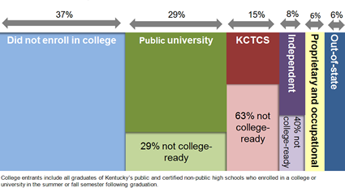
Recent enrollment data confirm that these barriers do keep many high school students from pursuing the education dream.
Public university
KCTCS
Source: Kentucky Council on Postsecondary Education

Slide 25
Marketing & Communications

Slide 26
Prospects are collecting more information and requesting more feedback than ever before as they consider their educational alternatives. This is especially true for the older prospects.
Percentage Point Change From 2006
Information Sources Used
Older Prospects
High School Students
Parents
Friends
Websites
Family Members
Campus Visit
Brochure
TV/Radio
Mail
Teacher/Counselor
18
29
7
12
17
11
13
7
7
3
11
3
1
29
1
1
9
22
9
16
11
8
4
16

Slide 27
The “buzz wheel” has never spun so fast or involved as many as it does today. Information sources and brand advocates will make a difference.
Information Interaction System
Friends/
Community
Parents
“Buzz”
Postsecondary
Schools
Peers
Teachers/
Counselors
“Search”
Student/
Prospects
Media
Campus
Visits
Web

Slide 28
Websites have become an even more important part of the information collection process, especially for older prospects.
Website Visitation Of College Considered
-4
+15
+11
-5
Any Website
KCTCS Website
Any Website
KCTCS Website
Older Prospects
High School Students

Slide 29
What an amazing story of successful strategy and execution. Every market segment recognized the KCTCS website improvement.
Evaluation KCTCS Website Vs. Competition
Percent “Extremely/Very Good”
Older Prospects
High School Students
+17
+7
+17
KCTCS
Competitor
KCTCS
Competitor

Slide 30
Teachers and counselors were also most affirming of the website effort and other improved KCTCS communication media.
Percent Excellent/Very Good
+12
+15
+12
+19
Website
College fairs
Collateral materials
Program information

Slide 31
Teachers and counselors were also more impressed with KCTCS’ work at schools and from the office than in 2006.
Percent Excellent/Very Good
+10
+14
Response to information requests
Helpfulness of staff
Community involvement
Frequency of contact
Involvement at high school

Slide 32
Brand Awareness, Image & Consideration

Slide 33
The “Brand Funnel” is a classic and reliable way to evaluate brand development from initial recognition to purchase.
Total Target Market
Awareness
Positive
Knowledge & Perception
Consideration
Likely
Purchase

Slide 34
All cohorts were more aware of KCTCS as a “system” than they were five years ago.
Brand Awareness: As A System
Percent Aware
+19
+17
+8
Teachers
Older Prospects
Parents
High School Students

Slide 35
Overall perceptions of KCTCS as a “system “ have improved among teachers, remained stable among parents and older prospects, but declined among high school students.
Brand Image: As A System
Percent “Extremely/Very Good”
+9
-9
Teachers
Older Prospects
Parents
High School Students

Slide 36
Name awareness of the KCTCS College closest to them was nearly universal as it was five years ago.
Brand Awareness: Closest KCTCS College
Percent Aware
Teachers
Older Prospects
Parents
High School Students

Slide 37
Overall perception of the KCTCS College closest to them was evaluated the same by older prospects but lower by high school students and their parents.
Brand Image: Closest KCTCS College
Percent “Extremely/Very Good”
-7
-16
Older Prospects
Parents
High School Students

Slide 38
The reasons for that declining image result from the success of attracting non-traditional students.
Has a less than stellar academic reputation
Lower academic reputation
Caliber of students not so good
H.S. Students
Teachers
Teachers

Slide 39
Teachers however are quick to reference KCTCS and have done so in significant numbers.
2011 Only
Recommended students…
Net Who Have Recommended Any
92%

Slide 40
Teachers also encourage students across a wide range of academic abilities to consider KCTCS for their next educational step.
Percent “Yes”
Not asked in 2006
-9

Slide 41
Conclusions & Recommendations

Slide 42
Conclusions & Recommendations
Conclusion
KCTCS has had an incredible impact on the educational landscape in Kentucky.
Since 2006 over 200,000 more prospects know about the KCTCS system and its 16 campuses across the Commonwealth.
Approximately 20,000 more students enrolled in 2010 compared to 2006.
More people have entered the world of higher education and even more are considering it.
Recommendation
Indentify the strategies most responsible for these successes and build upon them cognizant of the changing educational environment.

Slide 43
Conclusions & Recommendations
Conclusion
The enhancement of KCTCS communication materials and strategy has been clearly noted and appreciated by all target markets.
In-school focus on teachers and counselors is a perfect example.
The initiative to revamp the entire KCTCS web-presence was timely, essential and successful.
Recommendation
Use similar focus to develop comprehensive communication materials for older prospects, high school students and their parents.
Recognize that web media and social network development is never done and needs to be always new. It is a reality of a constantly changing and developing electronic world.

Slide 44
Conclusions & Recommendations
Conclusion
The economic environment has clearly had an impact on the market’s perception toward education in general.
“Successful Outcomes” that focus on Quality of Life, Employability, and Prosperity are clearly on target.
Recommendation
For the younger high school students the emphasis on Employability and Prosperity may even rise above the Quality of Life as values to promote.

Slide 45
Conclusions & Recommendations
Older Prospects
Younger Prospects
EMPLOYABILITY
QUALITY OF LIFE
PROSPERITY
EMPLOYABILITY
PROSPERITY
QUALITY OF LIFE

Slide 46
Conclusions & Recommendations
Conclusion
The older adult segment is a uniquely different market compared to the high school junior or senior.
Their goals and objectives are subtly different but their behaviors, perceptions and “life view” are dramatically different.
Recommendation
“One size will not fit all.” Marketing and communication materials must be distinctly different and targeted to specific needs and wants of each individual segment.

Slide 47
Conclusions & Recommendations
Conclusion
The older segment seems primed for even more growth as awareness of KCTCS and the number of brand advocates increase.
Recommendation
Develop a targeted marketing and communication program to the older segment that takes advantage of the profile of those most likely to pursue education (Age, Race, Marital Status, & Income).

Slide 48
Conclusions & Recommendations
Conclusion
The phenomenal success of KCTCS may have become its own “perceptual enemy” (Dilemma).
Teachers and Counselors believe the academic reputation and the caliber of students has declined. However they understand the mission and vision for KCTCS.
High school students and parents also think the reputation and caliber of students have declined. They have less positive perceptions and are less likely to consider KCTCS as an educational alternative.
As KCTCS continues to respond to the needs of students otherwise not considering postsecondary education and those struggling with their academics it reinforces a less positive academic image.
These students and their parents likely know that 63 percent of KCTCS enrollees are not college ready.

Slide 49
Conclusions & Recommendations
Public Universities
KCTCS
Academic reputation
Caliber of students
Source: Kentucky Council on Postsecondary Education

Slide 50
Conclusions & Recommendations
Recommendation
Develop a comprehensive market communication program to the traditional student/parent segment to parlay the good work already done with teachers and counselors.
Engage the entire “buzz network” in ways that allow KCTCS to define its brand image rather than allow parents and students to do it on their own.
Indications are that a direct mail campaign could be helpful.
Continue to encourage and reinforce the past successful work with teachers and counselors.
Remember that KCTCS is not usually part of the initial consideration set for many younger students; but will be as the reality of finances, academic prowess, study skills and life complications call for some adjustments. When KCTCS enters the “consideration set” it suggests “timed” communication strategies as part of this overall communication program.

Slide 51
Conclusions & Recommendations
Conclusion
KCTCS’ system-wide growth in awareness and image has created an “overarching brand” that can speak to the highest aspirations of the organization.
Recommendation
Optimize the growing brand awareness and positive image of KCTCS by integrating it with a strong College brand development program to enhance imagery and knowledge among traditional and nontraditional prospects alike.

Slide 52
Conclusions & Recommendations
Conclusion
Regardless of their personal perceptions and likely behaviors, a majority of prospects believe that a KCTCS College is an excellent or very good place to start college and then transfer to a four year college or university.
Because it’s close to home, costs less and offers smaller classes/more personalized attention.
Recommendation
Develop a more systematic and effective plan to encourage associate degrees and promote the ease of transferring credits to four year institutions.

Slide 53
Conclusions & Recommendations
Recommendation
Take the time to celebrate some amazing successes even as you reevaluate and strategize for a successful future.
Sincerely,
Horizon InSight

Slide 54
THAT WAS THEN…
…THIS IS NOW!
2011 Brand Market Assessment
June, 2011

